Slide 1
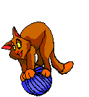
Computer Forensics
Investigation
of a
USB Storage Device
(FAT16)

Slide 2
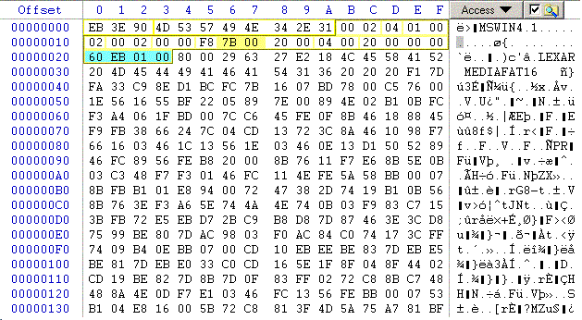
USB Storage Example
Identify FAT Boot Sector (Sector 0)
Find BPB

Slide 3
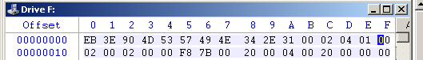
USB Storage Example
0B-0C: Bytes per Sector (little endian)
  00 02 → 02 00 = 512_{decimal}
0D: Sectors per Cluster: 04
10: Number of FATs: 02
Notes:
0E:保留扇区 00 02根目录项数 f8硬盘（u盘），f0软盘

Slide 4

USB Storage Example
16-17: Size of FAT is 00 7B sectors
There are two FATs
Conclusion:
  Root Directory starts at sector 1+7B+7B
  Go to sector 247
Notes:
7B=7*16+11=123 1+123+123=247

Slide 5
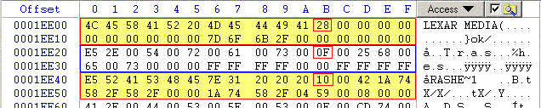
USB Storage Root Directory
Three entries.
Top: a short entry.
Then a long followed by the associated short entry.

Slide 6
USB Storage Root Directory
First Entry
  File attribute is 28 -> 0010 1000 b
  Volume marker is set
  Archive marker is set
  Volume Label
  Name is Lexar Media

Slide 7
USB Storage Root Directory
Time field is 7D 6F.
Translated from little endian 6F 7D.
Binary 0100 1111 0111 1101.
Hour is 01001 -> 9.
Minute is 111011 -> 59.
Creation time is 09:59.

Slide 8
USB Storage Device
Root Directory
Date field is 6B 2F.
Translated from little endian 2F 6B.
In binary 0010 1111 0110 1011.
Year is 001 0111 = 23 after 1980 ->2003
Month is 1011 = 11 = November
Day is 01011 = 11.
Formatted on the 11/11/2003.

Slide 9
USB Storage Device
Root Directory
First cluster is 00 00, obviously.
File size is 00 00 00 00.

Slide 10

USB Storage Device
Root Directory
Next two entries: a deleted long and short record.
File attribute 0F (long entry)
File attribute 10 (directory)
Leading byte 0xE5 (deleted)

Slide 11
USB Storage Device
Root Directory
Long entry file name: .Trashes
Short entry file name: TRASHE~1
Created by MACs
Deleted on 10/24/2003
582F -> 2F 58 -> 0010 1111 0101 1000

Slide 12
USB Storage Device
Root Directory
First cluster is 04 59 -> 0x 5904 -> 22788
Size is 00 08 00 00 -> 0x00 00 08 00 = 2048.

Slide 13
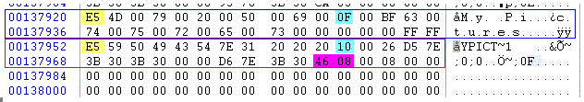
USB Storage Device
Root Directory
Go through the directory to find interesting entries.
At the end, a deleted directory called My Pictures.
Starts at cluster 0x0846

Slide 14
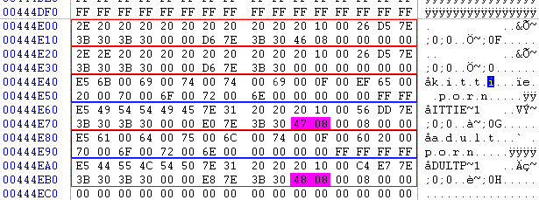
USB Storage Device
Directory
Go to this sector:
  Two deleted directories kittieporn and adultporn
  First starts at cluster 0x0847
Notes:
cluster 0x0846

Slide 15
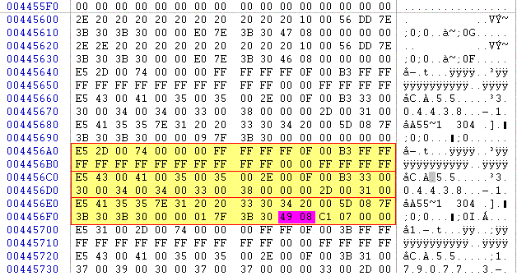
USB Storage Device
Directory
Sounds interesting: Go to cluster 0x0849
Notes:
cluster 0x0847

Slide 16
USB Storage Device
Directory Entry
File is called “CA55.304438-1-t”
Size is 0x07C1 = 1985, fits into 1 cluster
Starts at cluster 0x849.

Slide 17
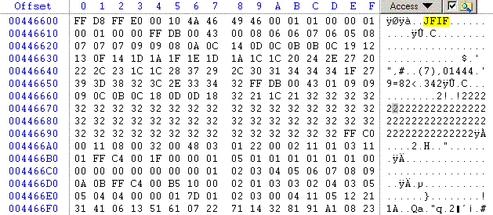
USB Storage Device
Deleted File
Magic number JFIF tells us that this is a JPEG file.
Go to file
Notes:
cluster 0x0849

Slide 18
USB Storage Device
Deleted File
Most files have these magic markers.
Learn how to identify them.

Slide 19
USB Storage Device
Deleted File
Use Winhex to save this block into a file.
Change file extension to JPG.
Now we can look at it.
Indeed, minors in a seductive position and completely naked!

Slide 20

USB Storage Device
Deleted File

Slide 21
Recovering Files
This was easy because we just followed directory entries.
WinHex actually calculates a lot of the values that we distilled by hand.
Reconstructs directory entries on its own.
But has no generic file previewer
这很容易，因为我们只需遵循目录条目。
WinHex实际上计算了很多我们手工提取的值。
自行重建目录条目。
但是没有通用文件预览器

Slide 22
Recovering Files
If directory entry is overwritten:
  Look for sectors in slack space.
  Look for files that have not been overwritten.
  Try to splice pieces of the file together from the FAT.
  Use pattern recognition software to guess file type.
  Result is frequently useful.
Notes:
splice粘接

Slide 23
Recovering Files
Text files:
  Search for Words in the Duplicate.
  Learn how word processors store files.
  Interesting finds, especially in old MS Word formats.

Slide 24

Recovering Files
JPEG uses blocks to compress.
Blocks can be interpreted individually.
Possible to read a partial JPEG file.
Do YOU want to create a tool?

Slide 25
Creating Evidence
Tie suspect to the computer and to incriminating files.
Establish a pattern of usage using MAC.
Photos can establish usage.
Emails can establish usage.
Remember: The prosecution must make the case.

